Slide 1
IMAGE KEY POINT DETECTION & TAGGING
Guide: Dr.C.Kiranmai
TEAM :
Reetish Chand (14071A05M7)
Anoop Reddy (14071A05I5)
Amar Koni (14071A05I4)
N.Rahul (14071A05L9)

Slide 2
ABSTRACT
Image tagging and key point detection finds applications in multiple domains such as security, medicine, social media, search engines etc. We are restricting images to faces of people in our application. Any image tagging & key point detection methodology involves face detection, key feature extraction and feature comparison to tag the correct person. Our project proposes using Histogram of Oriented gradients (HOG’s) technique coupled with convolutional neural networks to detect a face and mark key features from it. Then it uses a classification algorithm such as KNN to tag respective person. We also use few shearing and rotation operations to augment face detection when they are oriented in any angle.

Slide 3
EXISTING SYSTEM
Viola Jones algorithm was a break through which was fast enough to detect faces in real time and this was embedded into point and shoot cameras.
The algorithm looks for vertical bright bands(Noses),then horizontal dark bands(Eyes) and other general properties of a face.
The application of the Viola Jones algorithm was limited to face detection only and not recognition. Another disadvantage being the algorithm couldn’t accurately detect faces from other angles.
Metadata is hugely relied upon when doing image search/retrieval in the existing systems.
On the other hand, modern systems are only using HOG’s or CNN’s exclusively for recognition.

Slide 4
PROPOSED SYSTEM
CNN is indeed a faster and more accurate method of deep learning,
when applied to facial keypoint recognition. It gives results far too better than simple networks.Adjusting filter sizes, keeping larger filters for data input layers and decreasing the size in subsequent layers, produces better results. With further tuning of networks and large data size, the network is bound to improve .

Slide 5
TECHNOLOGIES USED
Histogram oriented gradients algorithm
Rotation and shearing algorithms
Convolutional neural networks and deep learning
Api’s & packages used :
Keras
KNN
Face Landmark Detection
Python 3.3 or above

Slide 6
Flowchart

Slide 7
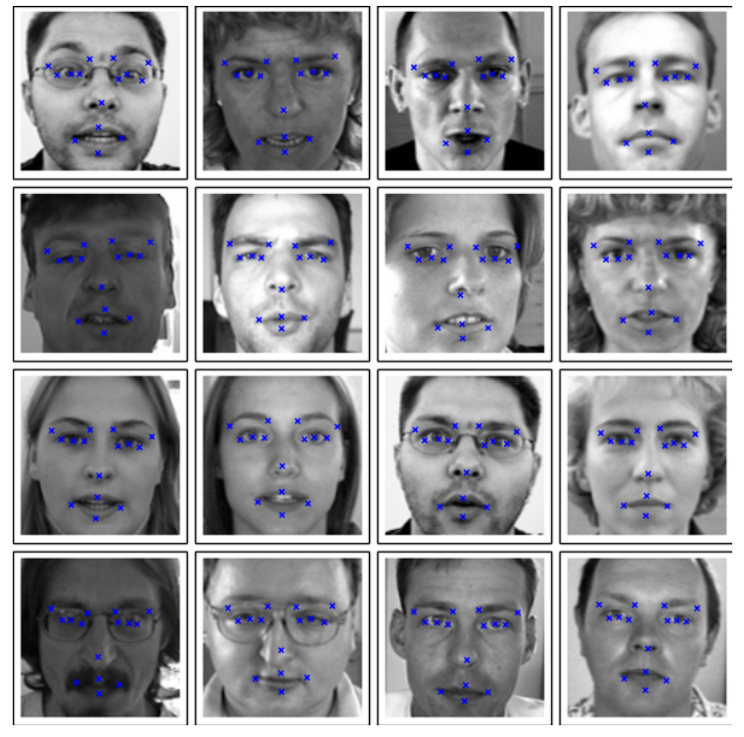
METHODOLOGY
Detect the key points using HOG. Output
features are as shown in the image.
Use Face Landmark estimation
Use rotation and shearing algorithms to
transform the images if required.
Store the extracted features in a separate
dataset/format for each image in the form of
a multi-dimensional matrix.
Pass the stored features as input to a
Convoluted Neural Network for training after which
the network outputs a 128D encoding for each image

Slide 8
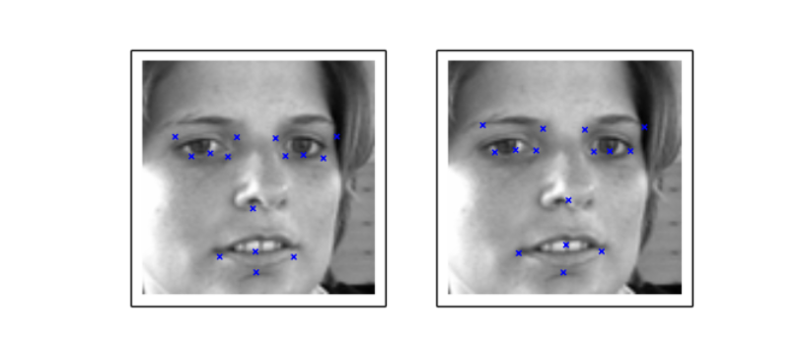
METHODOLOGY
Use a machine learning classification algorithm (K Nearest Neighbours) to predict the tag for the output encoding from the network.
Compare the accuracy with existing system.

Slide 9
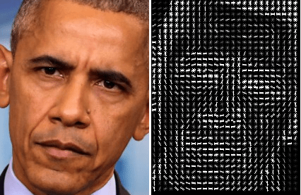
Histogram of Oriented Gradients (HOG’s)
At the start, we make our images black and white because we are only worried about the direction of light.
Considering each pixel with its neighbours we come up with a measure of how dark the current pixel is with respect to the neighbours.
As this process gives us too much detail, we instead consider 16X16 blocks of pixels.
This gives us an image with arrows pointing in the direction of darkness.

Slide 10
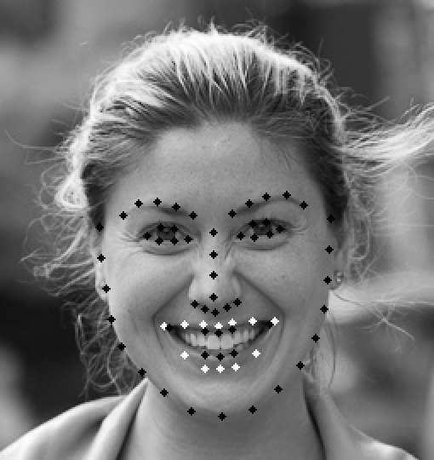
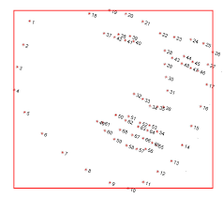
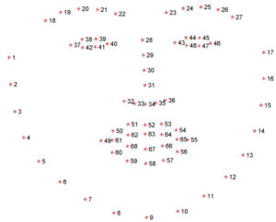
Face landmark estimation and 2D transformations
Now we use an algorithm called Face landmark estimation to find 68 points in our image known as landmarks.
Now if a face is oriented in any angle, we transform it to fit a centered result. For this purpose we use general rotation and shearing operations.
Map landmarks on left to right

Slide 11
What is CNN ?
Convolutional neural network (CNN) is a class of deep, feed-forward artificial neural networks that has successfully been applied to analyzing visual imagery.
CNNs use a variation of multilayer perceptrons designed to require minimal preprocessing.
A CNN can be defined using three components :
The convolutional layer
The Pooling layer
The output layer

Slide 12
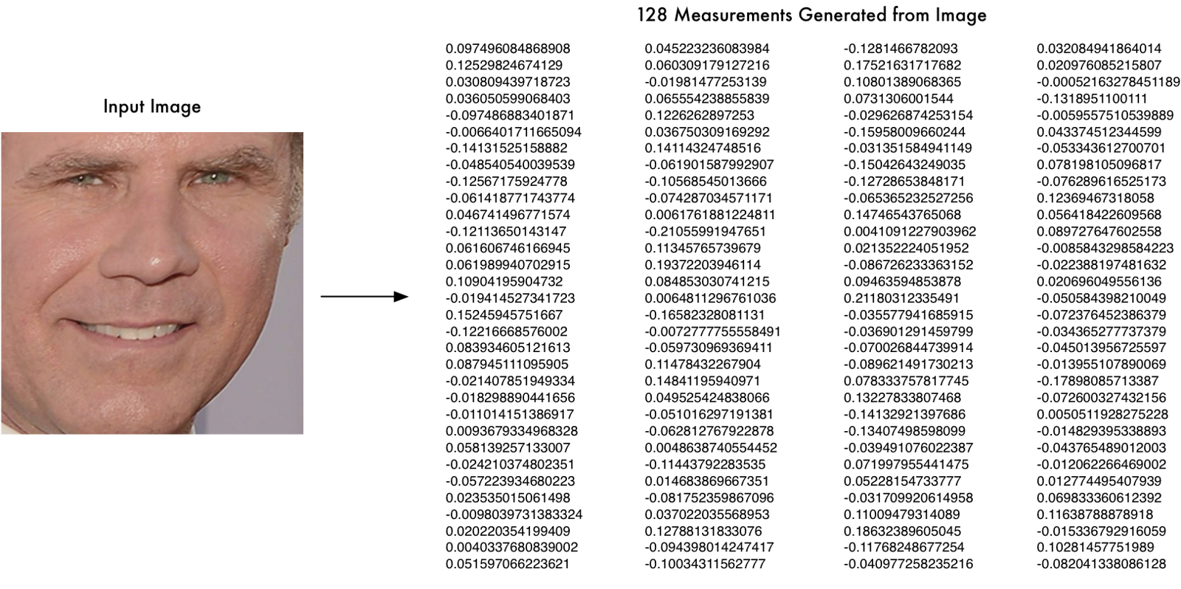
Use of CNN’s
This is where we extract features to aid in image tagging.
We train a convolutional neural network to find 128 important features that can uniquely define a person.
This network gives us those features as an array of 128 measures that act as our features.
After this we can use classification algorithms to label an image as a specific person. Support Vector Machines were found to be the most efficient for this purpose.

Slide 13
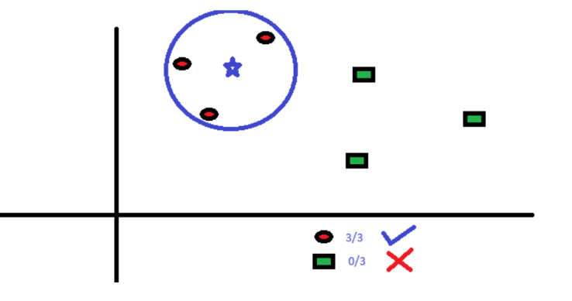
K- Nearest Neighbours
The 128- dimensional feature set from the previous step is plotted on a Euclidean space. Then, the most probable nearest neighbour is used to label the test image.
Other classification algorithms like SVM can be used if training set is large enough. But since we have a small set, KNN is used.
We will specify the value of K before training the KNN. We will also use a threshold distance to check the prediction for an outlier (in which case we will label the person as N/A).

Slide 14
USE CASES
Social media Tagging
Biometrics / face recognition
Real time face tracking in images and video for fraud detection
Analysing facial expressions
Detecting dysmorphic facial signs for medical diagnosis

Slide 15
FUTURE SCOPE
Extensive structural comparisons, with faster GPU training.
Feature extraction for objects.
Using 3D image mappings instead of 2D

Slide 16
REFERENCES
https://www.pyimagesearch.com/2017/04/17/real-time-facial-landmark-detection-opencv-python-dlib/
https://ibug.doc.ic.ac.uk/resources/facial-point-annotations/
Histogram of oriented gradients for human detection by Navneet Dalal & Bill Triggs
Google Inception deep neural network architecture

Slide 17
THANK YOU !

